Slide 1
My hobby during quarantine
Magdalena Bartosiak 8a

Slide 2
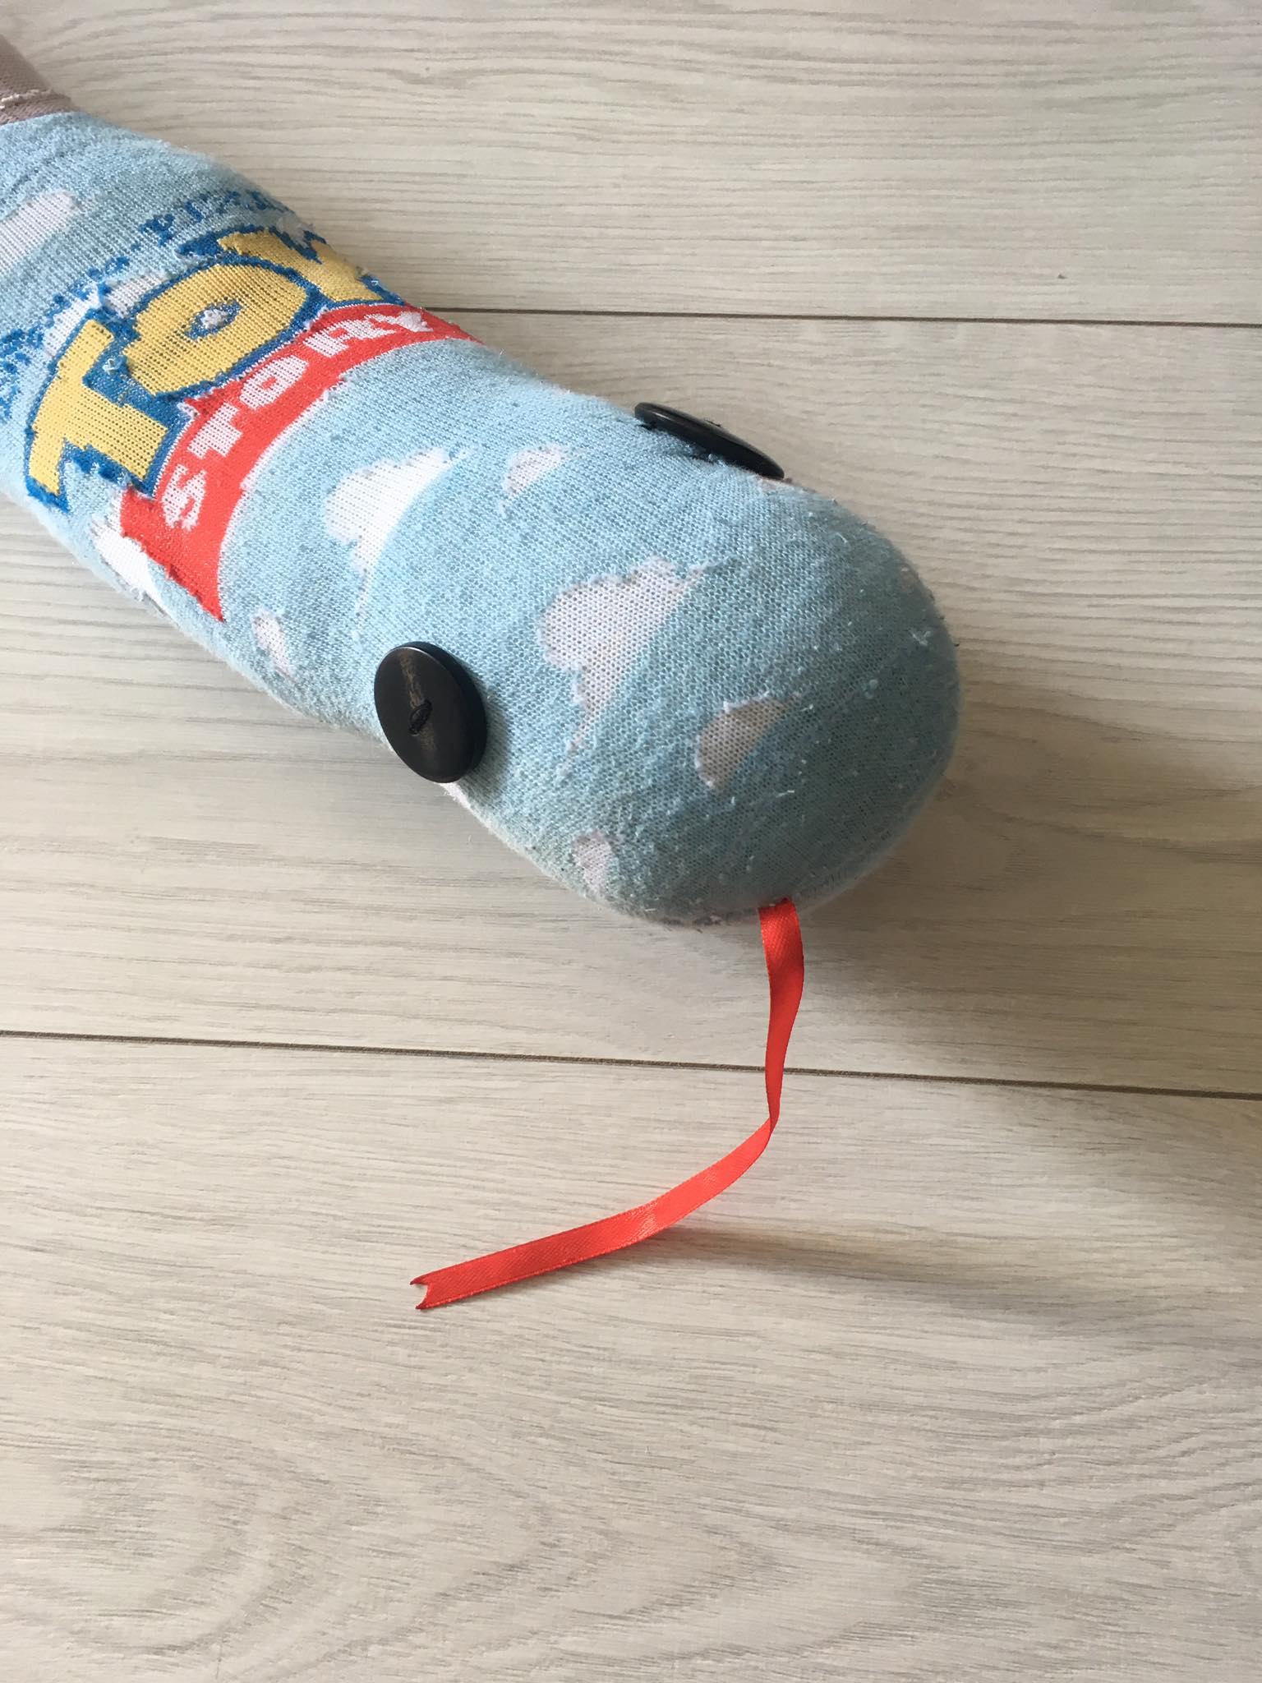
Sewing is my hobby during quarantine. I sew toys, aprons, masks, pyjamas and many more.

Slide 3
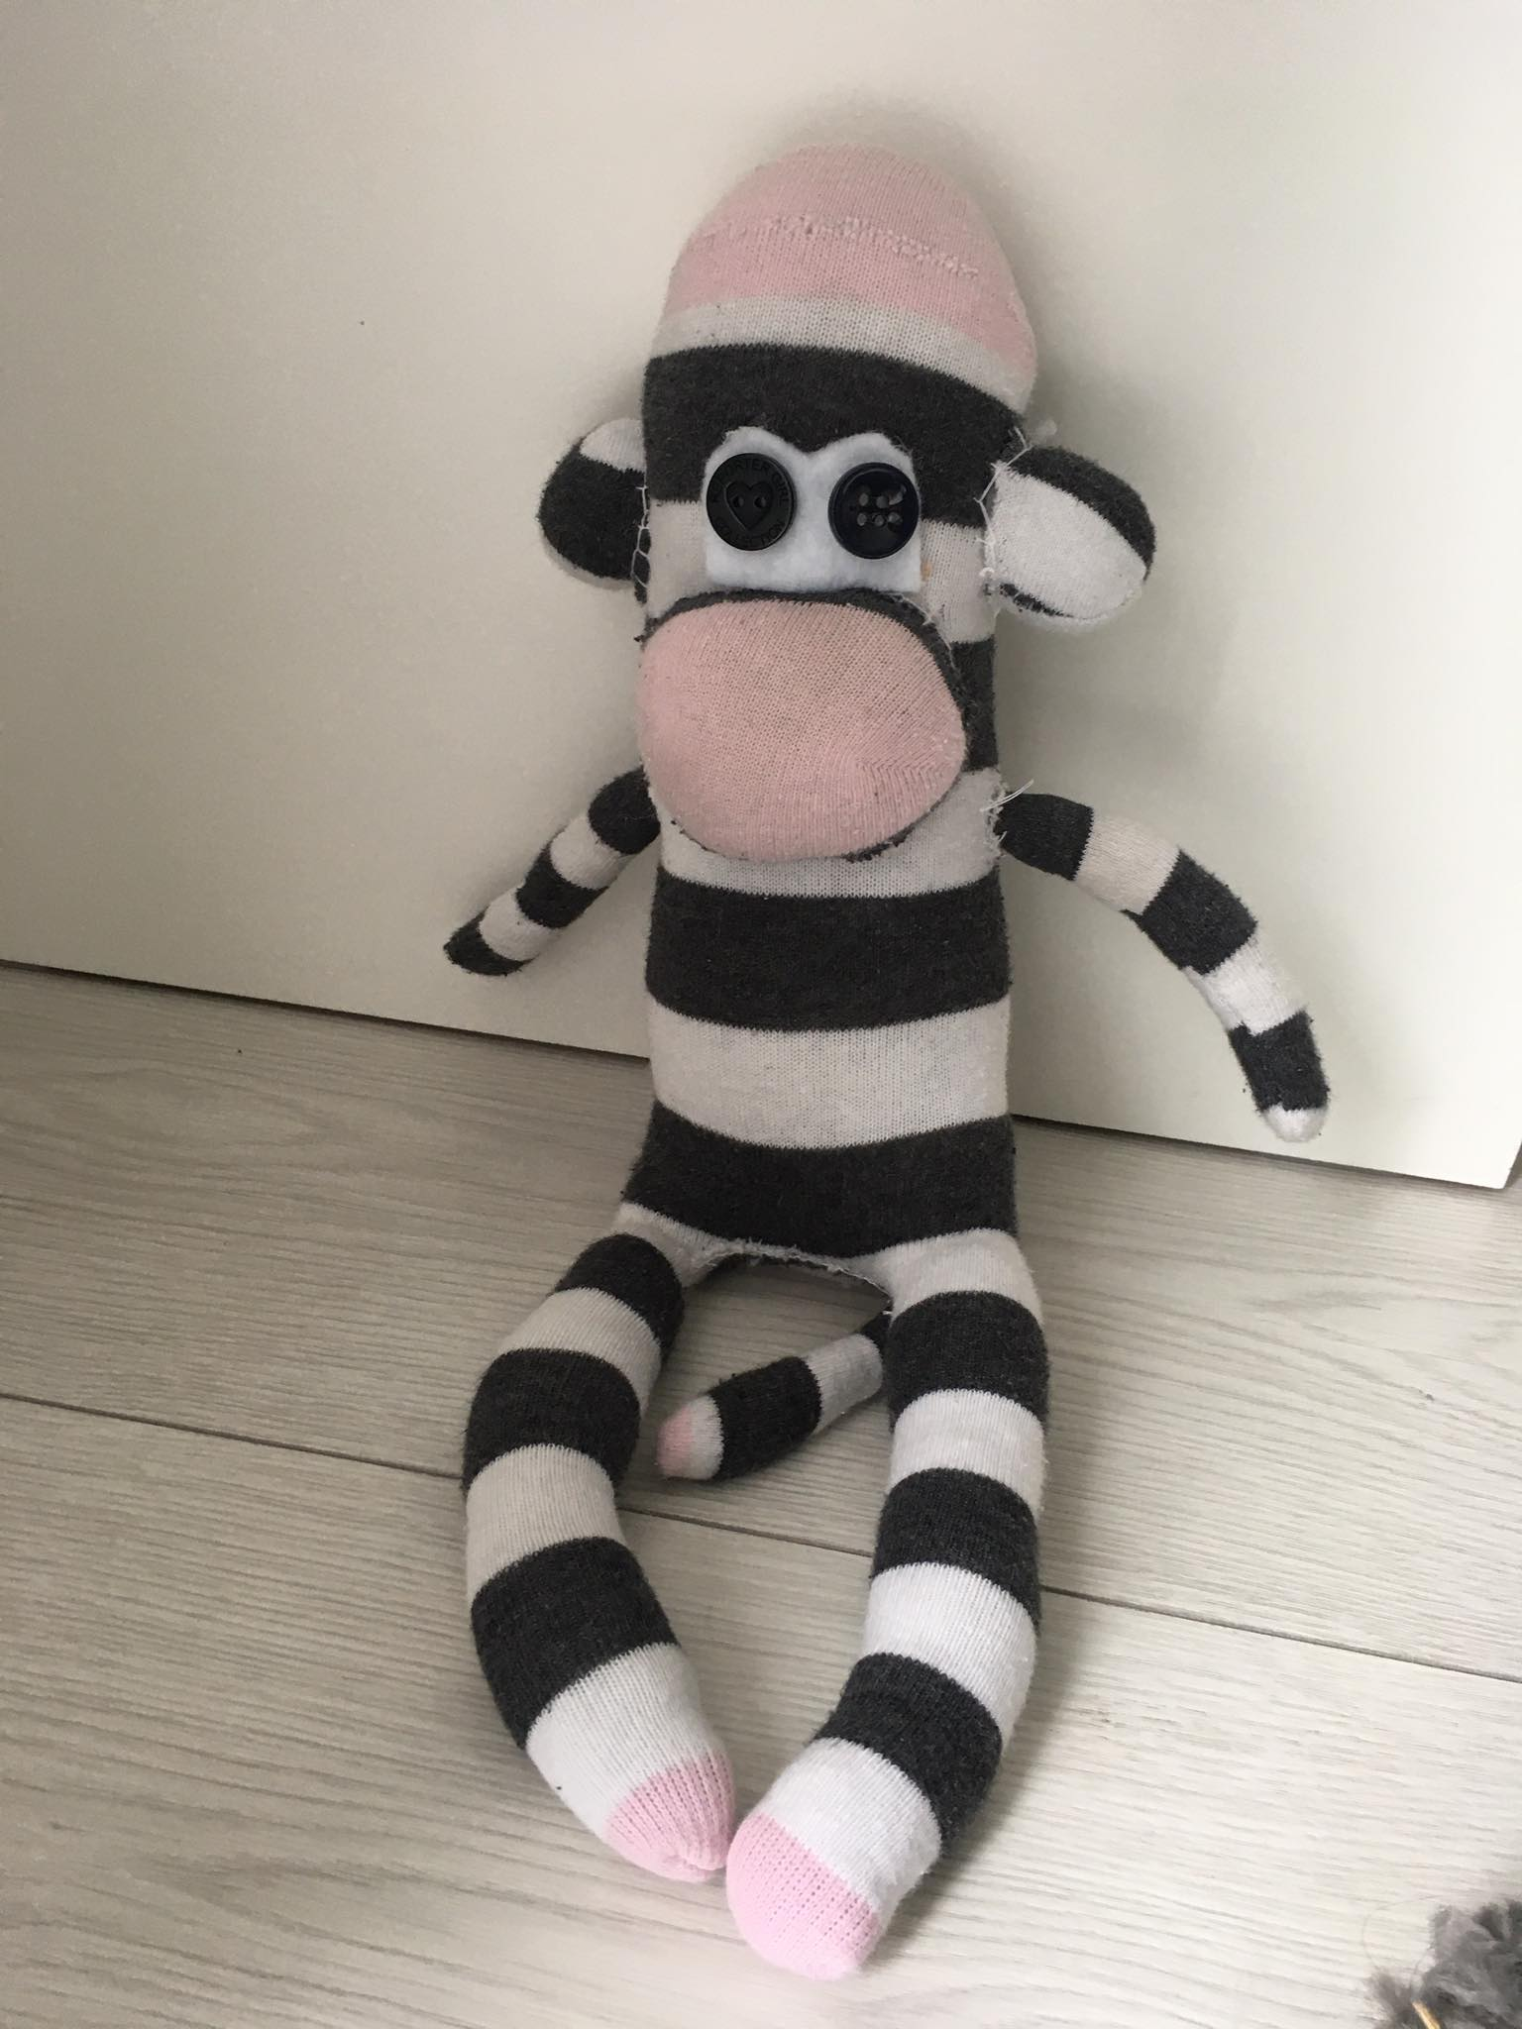
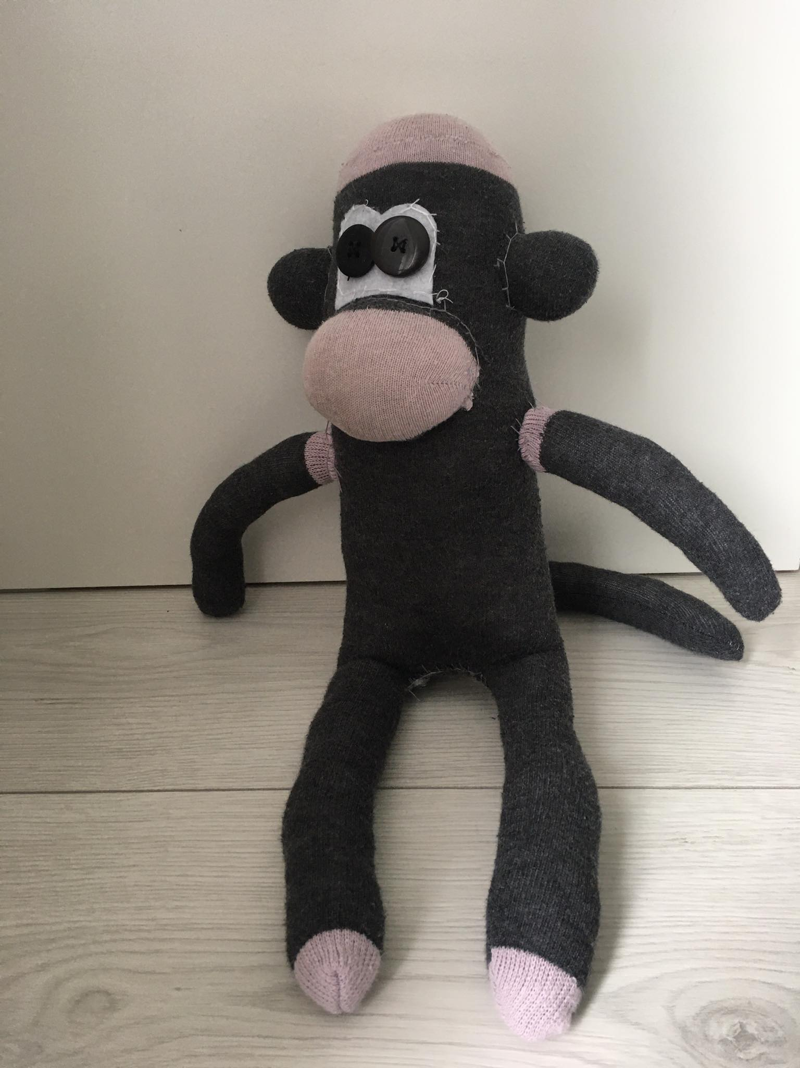
My hobby started when I was in 7th grade.
I was attending sewing lessons in Manufaktura in Lębork.
It was very interesting for me. I started to sew my first toys.
I got my sewing machine as a Christmas present.

Slide 4
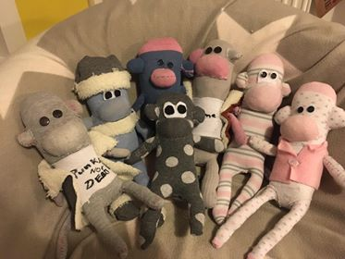
Unfortunately, I had to give up and concentrate on lessons in 8th grade. In the meantime, I saw how to make monkeys from socks. I decided to sew a few and give them as Christmas present to my friends.

Slide 5
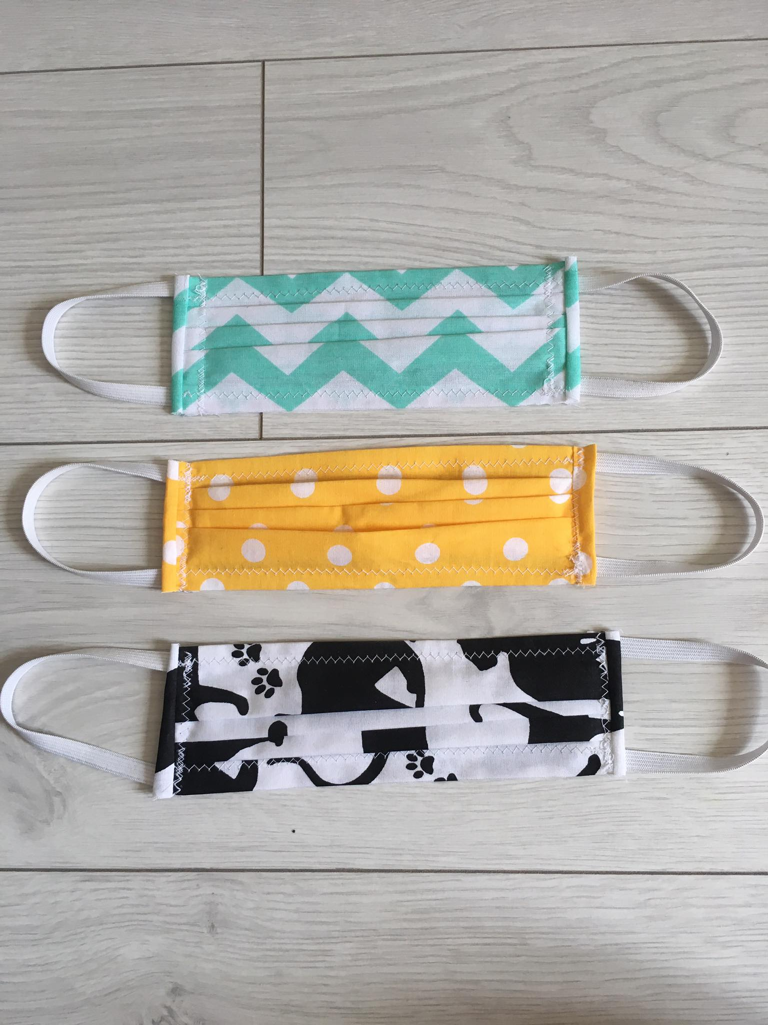
Than the coronavirus epidemic started and I thought about sewing masks to help people and earn some money.
My mum bought me cotton and I made over 150 masks. This was quite a successful business for me and a very good experience.

Slide 6
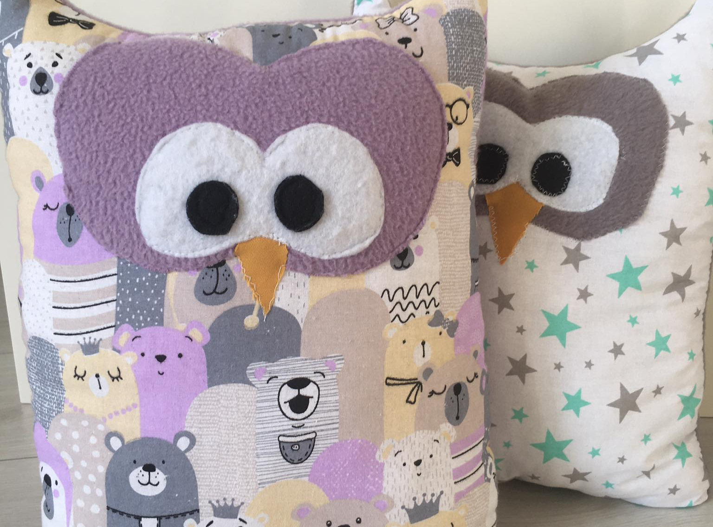
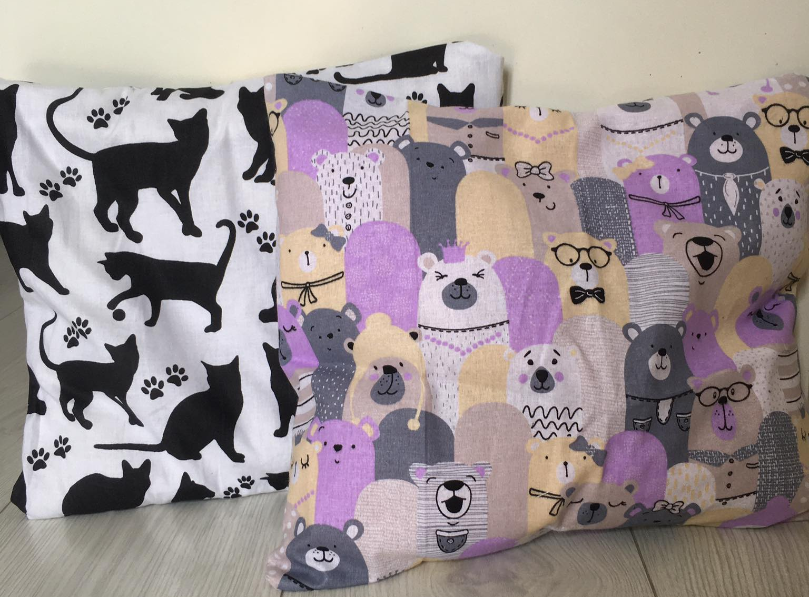
The quarantine time helped me to come back to my hobby.
I started to create toys. Made aprons and pyjamas for my mom for Mother’s Day.
I think sewing is a very useful skill. Things made by yourself give you more satisfaction and are more valuable.

